Slide 1
HR Analytics – JOB CLASSIFICATION
Pawan Nagar

Slide 2
Problem Statement
HR is not just about hiring people it is an ocean of its own. HR department goes through a constant journey of finding, selecting, onboarding and monitoring the right talent. You are required to use analytics concept to provide a smooth monitoring of workforce for the HR department. Job classifications reflect both job families and pay grade related information. This is especially relevant when new jobs are created which need to fit in the existing job structure. Jobs have a number of distinct features which impact the job’s classification. These include education level, experience, organizational impact, level of supervision, financial budget, and more. Knowing these factors for different jobs enables a job analyst to classify jobs into groups – which are connected to pay scales and benefit packages. Sundmark points out that Linear Discriminant Analysis (LDA) can be used to find combinations of features which characterize a number of classes of objects or events. Using LDA, Sundmark’s job classification data set can be used to classify newly created jobs in the existing job structure, providing guidelines for newly created functions.

Slide 3


Tools used
Business Intelligence tools and libraries works such as Excel, Power BI are used to build the whole framework.

Slide 4
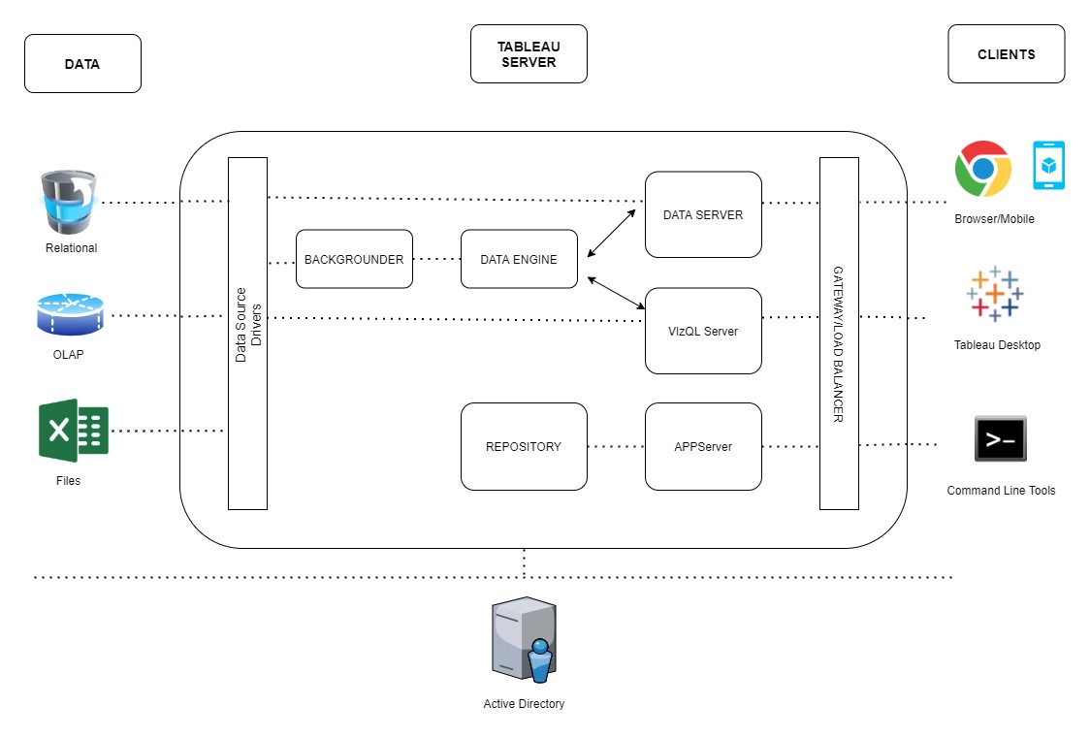
Tableau Architecture
Tableau has a highly scalable, n-tier client-server architecture that serves mobile clients, web clients and desktop-installed software. Tableau Server architecture supports fast and flexible deployments.
The following diagram shows Tableau Server’s architecture:
.
Tableau Server is internally managed by the multiple server processes.
Gateway/Load Balancer
It acts as an Entry gate to the Tableau Server and also balances the load to the Server if multiple Processes are configured.
Application Server:-
Application Server processes (wgserver.exe) handle browsing and permissions for the Tableau Server web and mobile interfaces. When a user opens a view in a client device, that user starts a session on Tableau Server. This means that an Application Server thread starts and checks the permissions for that user and that view.
Repository:-
Tableau Server Repository is a PostgreSQL database that stores server data. This data includes information about Tableau Server users, groups and group assignments, permissions, projects, data sources, and extract metadata and refresh information.

Slide 5
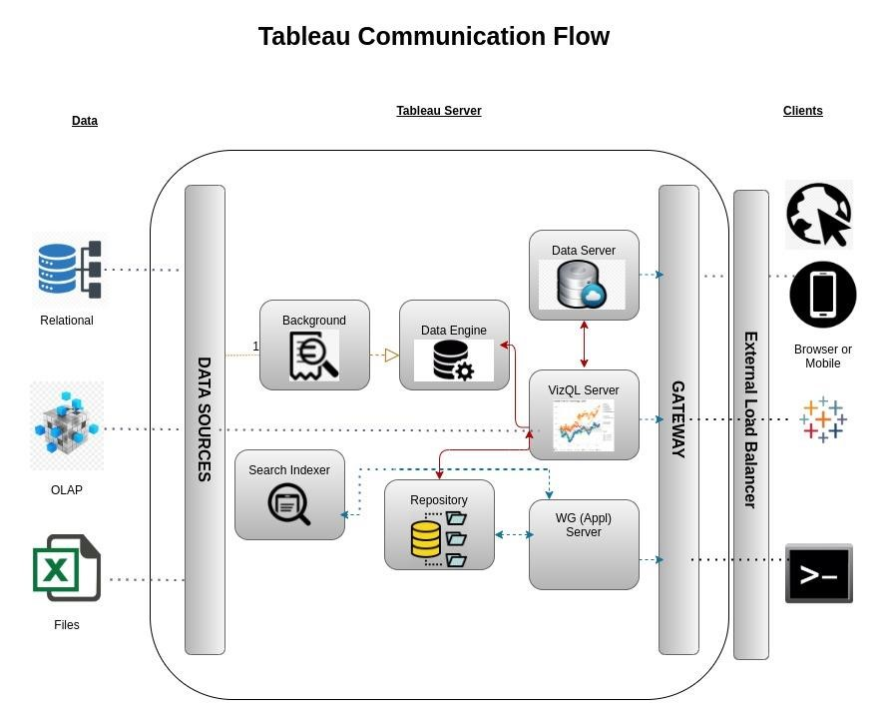
VIZQL Server:-
Once a view is opened, the client sends a request to the VizQL process (vizqlserver.exe). The VizQL process then sends queries directly to the data source, returning a result set that is rendered as images and presented to the user. Each VizQL Server has its own cache that can be shared across multiple users
5) Data Engine:-
It Stores data extracts and answers queries
Backgrounder:-
The backgrounder Executes server tasks which includes refreshes scheduled extracts, tasks initiated from tabcmd and manages other background tasks.
Data Server:-
Data Server Manages connections to Tableau Server data sources
It also maintains metadata from Tableau Desktop, such as calculations, definitions, and groups.
Tableau Communication Flow

Slide 6
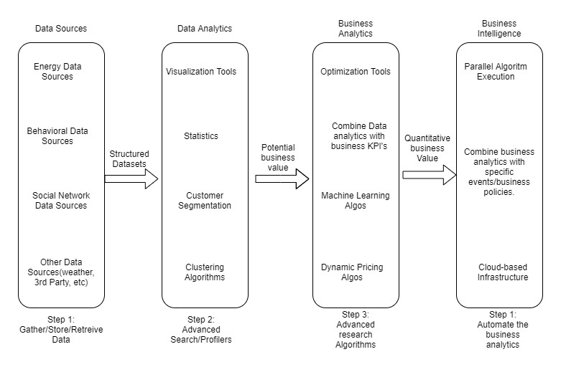
Functional Architecture
Figure 1: Functional Architecture of Business Intelligence

Slide 7
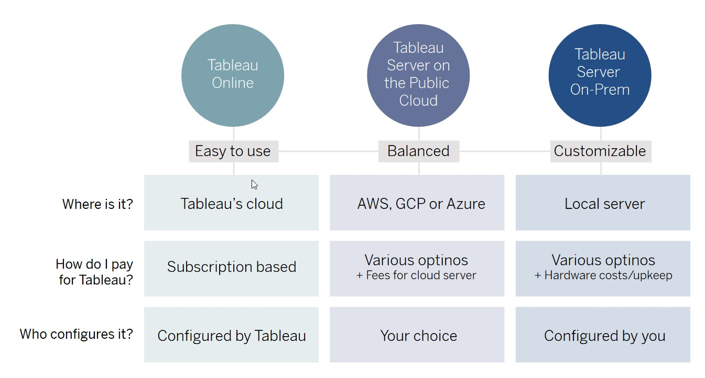
. Deployment Description
Tableau Online Get up and running quickly with no hardware required. Tableau Online is fully hosted by Tableau so all upgrades and maintenance are automatically managed for you.
Tableau Server deployed on public cloud: Leverage the flexibility and scalability of cloud infrastructure without giving up control. Deploy to Amazon Web Services, Google Cloud Platform, or Microsoft Azure infrastructure to quickly get started with Tableau Server (on your choice of Windows or Linux). Bring your own license or purchase on your preferred marketplace.
Tableau Server deployed on-premises: Manage and scale your own hardware and software (whether Windows or Linux) as needed. Customize your deployment as you see fit.

Slide 8

HR Analytic job classification
Wireframe
As per the problem statement, we have divided analysis into three sections: -
Some Tiles for Quick Analysis:
In this section of dashboard, we tried to interpret the followings:-
First tile show that total job of class
Second tile show that count of total family
Third tile show type of education

Slide 9
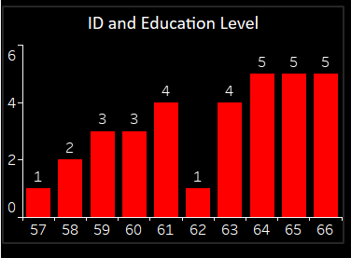
Filters Of Dashboard
section represent type of education level: - total id and total education level
Column chart are represent that how increase education level

Slide 10
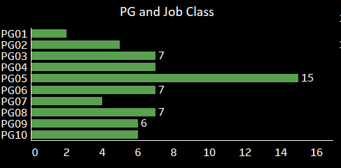
Bar chart are represent that PG and job class

Slide 11
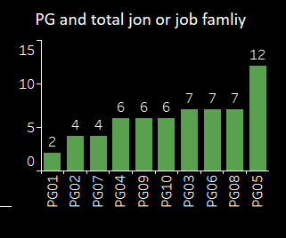
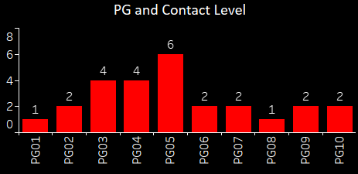
This column chart are represent that :-
First column chart find relations PG and job , job family's
Second column chart are represent PG and his contact level

Slide 12
Thankyou !

